Slide 1
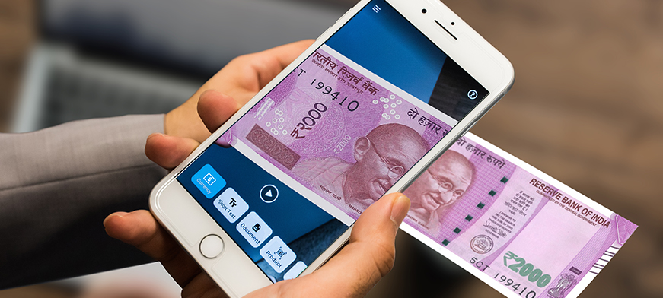
MOBILE ASSISTIVE TECHNOLOGY
BY
KARISHMA S. KARAD

Slide 2
INDEX
ABSTRACT
INTRODUCTION
GOALS AND INTERPRETATION
Challenges in practices and application
Use among visually impaired and blindness
Usability evaluation for visual impairment
Conclusion
Recommendations

Slide 3
Abstract
Blind people are confronting a number of challenges in performing activities of daily life such as reading labels on a product, identification of currency notes, exploring unknown spaces, identifying the appearance of an object of interest, interacting with digital artifacts, operating a smartphone’s user interface, selecting non-visual items on a screen, etc.
The emergence of smartphone-based assistive technologies promotes independence, ease of use, and usability resulting in improved quality of life yet poses several challenging opportunities. We have reviewed research avenues in smartphone-based assistive technologies for blind people, highlighted the need for technological advancements, accessibility-inclusive interface paradigm, and collaboration between medical specialists, computer professionals, usability experts, and domain users to realize the potential of ICT-based interventions for blind people.
This paper analyzes a comprehensive review of the issues and challenges for visually impaired and blind people with the aim to highlight the benefits and limitations of existing techniques and technologies. Future research ventures are also highlighted as a contribution to the field.

Slide 4
Introduction
Advances in information technology (IT), and in particular mobile technology, are increasing the scope for IT-based assistive technologies to support a better quality of life for individuals with disabilities, including visual impairment. Technology has the potential to enhance individuals’ ability to participate fully in societal activities and to live independently.
The domain of IT-based assistive technologies is broad, as is the range of support such technologies can provide. The past few years have seen an increasing trend for ubiquitous computing – that is, a model of human-computer interaction in which the technology fits into the natural human environment.
With truly ubiquitous computing, users may engage in everyday activities not even conscious that they are using IT to accomplish them. When ubiquitous computing is directed to deliver assistance to individuals with disabilities, the concept of mobile assistive technologies emerges.

Slide 5
GOALS AND INTERPRETATION
The technologies have evolved significantly over the years, from a simple typewriter built in the 19th century to help blind people write legibly C to a mobile phone application helping visually-impaired individuals to ‘see’ and understand their surroundings. Assistive technologies have the potential to enhance the quality of life of visually-impaired persons via improved autonomy and safety.
Furthermore, by encouraging them to travel outside their normal environment and to interact socially, these technologies can decrease their fear of social isolation. There are various definitions of assistive technology. Common to them all, however, is the concept of an item or piece of equipment that enables individuals with disabilities to enjoy full inclusion and integration in society.
Traditional assistive technologies include white canes, screen readers, walkers, etc. Modern mobile assistive technologies are more discrete and include (or are delivered via) a wide range of mobile computerized devices, including ubiquitous technologies like mobile phones. Such discrete technologies can help alleviate the cultural stigma associated with the more traditional (and obvious) assistive devices.
We interchangeably use ‘mobile assistive technology’ and ‘assistive technology’ to refer to mobile IT-based solutions or enhancements for facilitating the independence, safety and overall improved quality of life of individuals with visual impairment. By defining assistive technology in this way we are by no means restricting our focus to assistance provided via small mobile platforms – our definition extends to include robotics as well as the accumulation of co-located and embedded technologies to create smart homes (as is discussed later).

Slide 6
Challenges in practices and application
There is not a single app that fits all purposes. Therefore, initial assessment of the requirement for the apps will be required and followed by tailoring the training program to meet the specific needs. There is a need of developing training guidelines on use of such accessible apps or features that will facilitate to recommend appropriately for various types of functions and vision loss, e.g., reduced vision acuity, visual field loss, reduced contrast sensitivity or clinical findings. Using multiple apps in a smartphone may consume more power from the battery.
So, there is a need of a good quality battery to operate extended periods of time, especially for smartphones used by visually impaired people. A due attention to improve awareness, on digital training, data security, back-up in the event of lost or theft of smartphones could be challenges among people with visual impairment.

Slide 7
Accessible built-in features of smartphones
Features | Operating system | Operating mode | Descriptions
Voice assistant (Google assistant, Siri) | iOS/Android | Audio based | Ask it a question. Tell it to do things
TalkBack | Android | Audio based | Screen reader
VoiceOver | iOS | Audio based | Screen reader
Text to Speech/Voice recognition | iOS/Android | Audio based | Read aloud
Select to speak | iOS/Android | Audio based | Select to speak, Speak selection
Zoom magnification/Font size | iOS/Android | Visual based | Zoom in the display
Contrast | iOS/Android | Visual based | Differences between an object and its background.
Invert colors | iOS | Visual based | White becomes black, black becomes white, orange becomes blue.
Voice Inputs Keyboards | iOS/Android | Audio based | Typing through voice command

Slide 8
Use among visually impaired and blindness
In a global survey on the use of accessible apps, more than 95% of people with visual impairment reported that these special apps were useful, and being used to accomplish their daily activities. The most frequently use apps were Be My Eyes, ColorID, CamFind, followed by screening reading and writing apps, e.g. TalkBack, KNFB Reader BrailleTouch. The study population of this global survey highlighted about the satisfaction of these special accessible apps of smartphones.
In many cases, the smartphones apps can function for multipurpose tasks that facilitate independence living. Natalina et al. study also highlighted that the smartphones are replacing many traditional assistive solution to a great extend in doing daily activities. A few studies reported that participating in digital arenas and accessing digital technology, including smartphones, reduce loneliness feeling, improve social contact, information sharing, gaining a better interaction with friends and family.
A study on tele-rehabilitation services for visually challenged students, in which smartphones were used exclusively, reported that smartphones based tele-health services offer a safe and an efficient way of providing all reliable information of COVID-19 pandemic, including various preventive strategies among students with visual disability. Such a tele- health services help to avoid the direct face to face contact between providers and patients. The study also highlighted such a platform helps in psychological counseling for fear and panic, facilitating and addressing the many unseen challenges faced by visually disabled people during the lockdown and pandemic period.

Slide 9
Usability evaluation for visual impairment
People with visual impairment have a unique requirement to be able to interact with smartphone assistive technology. Such a unique requirement can cause a gap between the ideas of the developers of smartphones and the needs of individuals with visual impairment, leading to either a lack of adoption or abonnement of smartphone. There is an obvious need of collaboration between vision rehabilitation professionals and expertise in computer sciences and involvement of visually challenged individuals, and their participation, in designing an innovative, acceptable, and adaptable mobile assistive technology that will assist to develop a user-centred technology.
Therefore, usability testing or evaluation while developing of accessible features and apps for smartphones is essential so that the features and apps are accepted and adopted by the end users. For examples, a smartphone may have many built-in multiple functions, but if it may not be usable to target population due to inaccessible or discomfort on use. A systemic evaluation on the usability testing should be a part of developing for accessible features and applications of smartphones. Designers or ergonomics engineers may face various challenges to perform usability evaluation for assistive products in an efficient way. Several factors may account for this, such as multiple influencing factors, so many non-specific tests and evaluation methods.

Slide 10
Conclusion
Individuals with visual impairment and blindness face various challenges and barriers in their everyday lives. These people need assistive technology to overcome these challenges and perform a wide range of daily activities, including reading and writing. These technologies vary from low technology to high end and specialized technology, including software programs. In the recent times, mobile technology has gained a lot of attention across the world and are incorporated many advance computer and information technologies features.
Smartphones, the most sophisticated mobile technology, have been developed as smart assistive technology for people with visual impairment in the few years with many accessible built-in features and accessible applications with the help of sound, haptic and gestures interaction, instead of vision-smartphones interaction. Such innovative accessible, user-centred and friendly technology has provided a new platform and opportunities for people living with visual impairment to overcome the very challenges and barriers encountered in their everyday lives.
Many accessible apps have been shown to be of great value and support in performing a wide range of daily living activities in people living with visual impairment. Such technologies are less likely attached with a stigma compared to traditional assistive devices. Further, use of smartphones have certain advantages, such as easily portable, less discomfort on use, relatively low cost compared to some of traditional devices. With widespread availability of mobile technologies along with eyes-free human smartphones features and applications, there might be a corresponding need of developing a clinical guideline on the use of accessible features and applications.

Slide 11
RECOMMENDATIONS
Now days, smartphones become a part and parcel of everyone lives, irrespective of health or disabilities. As of today, smartphones are asset of the general population who are sighted. However, with the help of accessible apps and built-in feature developed in the past few years, people with visual impairment and blindness can access smartphones and use for varied purposes. Now, it is time to scale up its use among visual impairment and blindness.
Therefore, there is a strong need for sensitization, promotion of smartphones as assistive technology in health or eye care facilities across the globe, even in educational institutions. Integration of smartphones services as assistive technology for visual impairment, in all eye care practices, but not limited to vision rehabilitation, would be helpful in improving the accessibility of it. Considering the demand as well as requirement for smartphones among people with visual impairment, a strong and effective advocacy is the need of the hour, especially in low middle income countries.

